Slide 1
Ship It Good
Deploying .NET Core Like a Pro

Slide 2


But I Want Something Easier!!!
Where We Came From
Compilation
MSBuild/CodeDOM > csc.exe
Libraries
Loose, GAC, NuGet
Application Frameworks
FCL, GAC, NuGet
Web Server
IIS
Platform Libraries
.NET BCL and FCL
Runtime
.NET CLR
Runtime Loader
IIS: WebEngine4.dll; EXE: OS
Operating System
Windows

Slide 3
But I Want Something Easier!!!
.NET Core Changes Everything
MSBuild/CodeDOM > csc.exe
Compilation
.Net Core CLI (Roslyn)
Loose, GAC, NuGet
Libraries
NuGet, npm
FCL, GAC, NuGet
Application Frameworks
NuGet
IIS
Web Server
IIS, HTTP.SYS, Kestrel
.NET BCL and FCL
Platform Libraries
.NET BCL and FCL; .NET on NuGet
.NET CLR
Runtime
.NET CLR; .NET Core CLR
IIS: WebEngine4.dll; EXE: OS
Runtime Loader
.Net Core CLI
Windows
Operating System
Windows, OSX, Linux

Slide 4
First, We Must Build

Slide 5
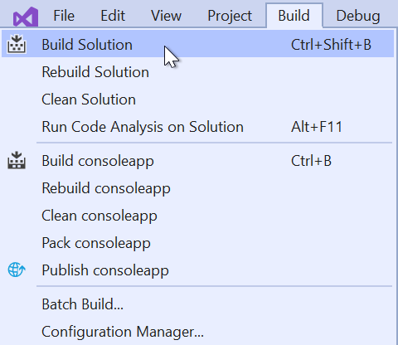
Building with Tools
Visual Studio
Configure different build configurations
Run multi-proc builds
Customize aspects of build system (output directory, events, logs)

Slide 6
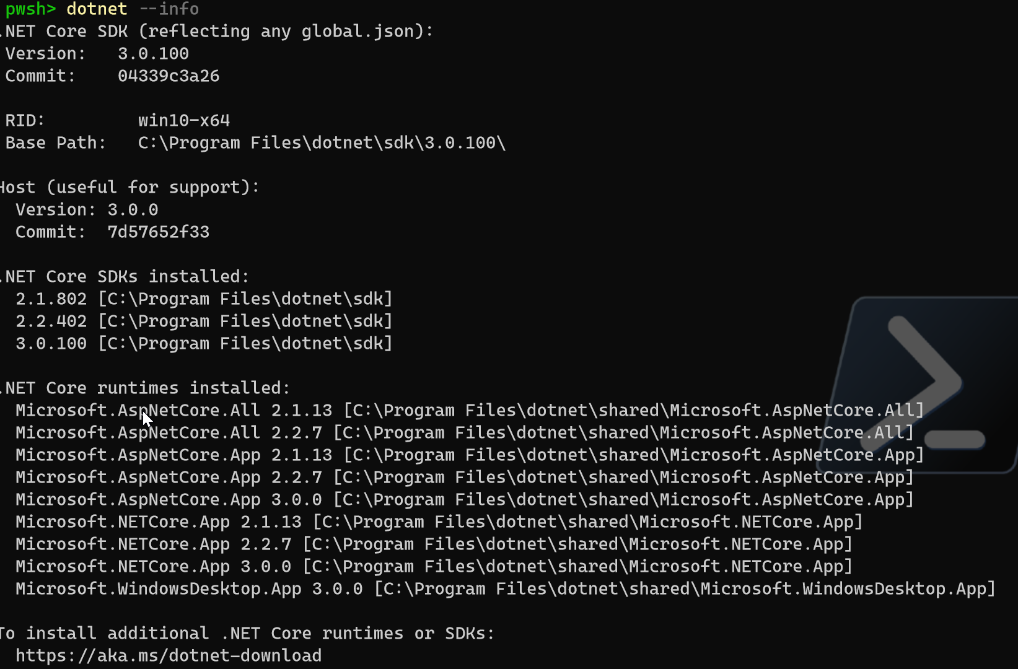
But I Hate IDEs!!!
Say Hello to the CLI
Installed with .NET Core
Runs same things as Visual Studio
Scripts can be moved to DevOps Tool
You OWN the whole process

Slide 7
Then We Will Deploy

Slide 8
Deployment Options on .NET
Framework-dependent Deployment (FDD)
Self-contained Deployment (SCD)
Framework-dependent executables (FDE)
Self-contained executable (New with .NET Core 3.0)

Slide 9
Framework-dependent Deployment (FDD)
Pros
.NET Core Runtime exists on server already
Deploy Just your Code (smaller deployment package)
Do not have to define target OS
Faster (just deploying your app)
Cons
Dependent on having an installed runtime
Upgrading the runtime may break your app (like all other upgrades)

Slide 10
Self-contained Deployment (SCD)
Pros
Deploy your app, all dependencies and the version of .NET Core
Requires .NET Core native pre-reqs (OS dependent)
Sole control of .NET Core version installed and target system config
Cons
Large deployment package (since .NET Core is along for the ride)
Globalization Invariant Mode helps with this
Must choose target platform at build

Slide 11
Framework-dependent executables (FDE)
Pros
Similar to FDD but for .exe based applications
Deployment folder has .exe with multiple .dlls
Cons
Dependent on .NET Core existing on host system
You must publish your app for each target

Slide 12
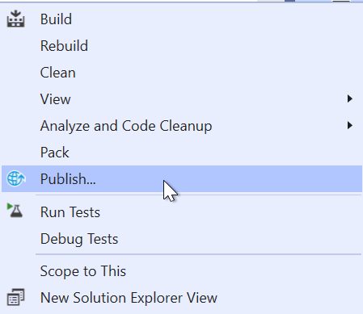
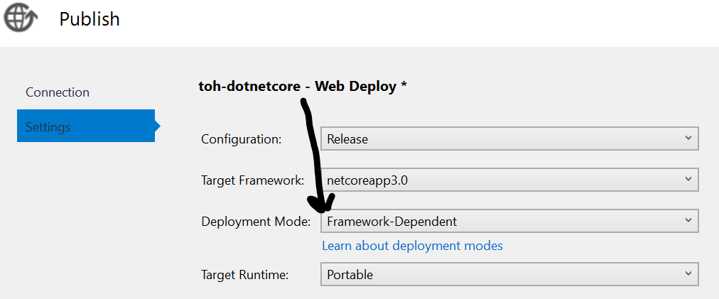
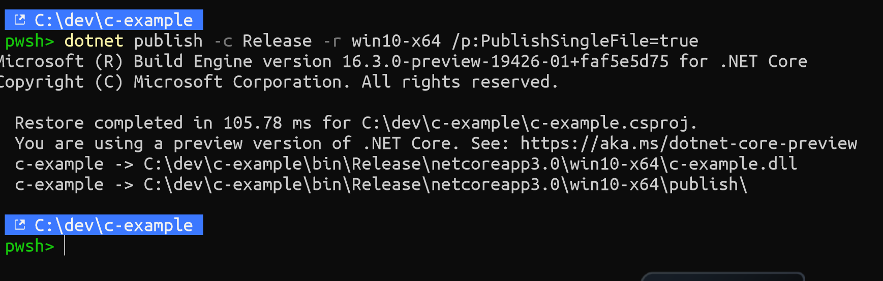
Getting Code off My Machine
Using Some IDE
Using the CLI

Slide 13
Getting Code off My Machine
Using Some IDE
Using the CLI

Slide 14
Let’s Build & Publish Some Code!

Slide 15
I Guess We Have to Talk DevOps

Slide 16

Why Publishing from VS Fails
You May Have Code Others Don’t
You May Have something on your machine others don’t
You May Have Not Run Tests
See a Trend Here?

Slide 17
But I Want Something Easier!!!
Why Publishing from VS Fails
You May Have Code Others Don’t
You May Have something on your machine others don’t
You May Have Not Run Tests
See a Trend Here?

Slide 18
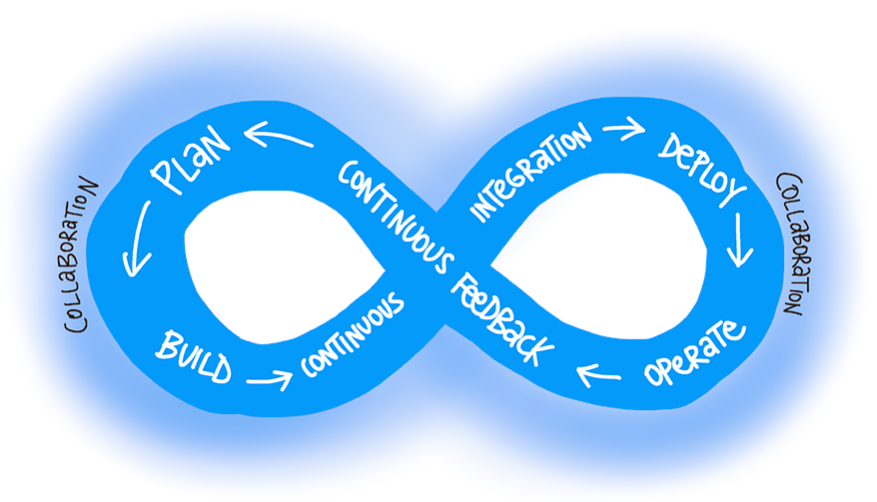
Ok, So What is THE Better Option?

Slide 19
But I Want Something Easier!!!
Ok, So What is THE Better Option?

Slide 20
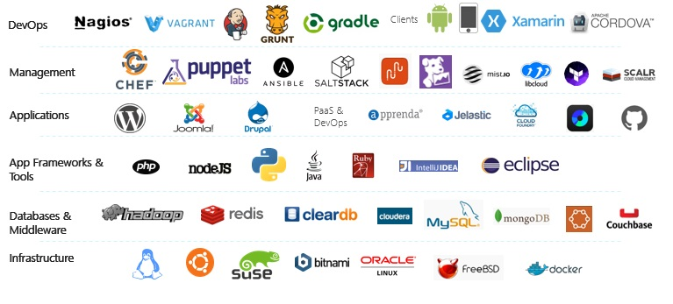
But I Want Something Easier!!!
What Tools Can I Use?
Tools that are aligned with DevOps…. Waaaaaay too many

Slide 21
What Tools Can I Use?
Tools that are aligned with DevOps…. Waaaaaay too many

Slide 22
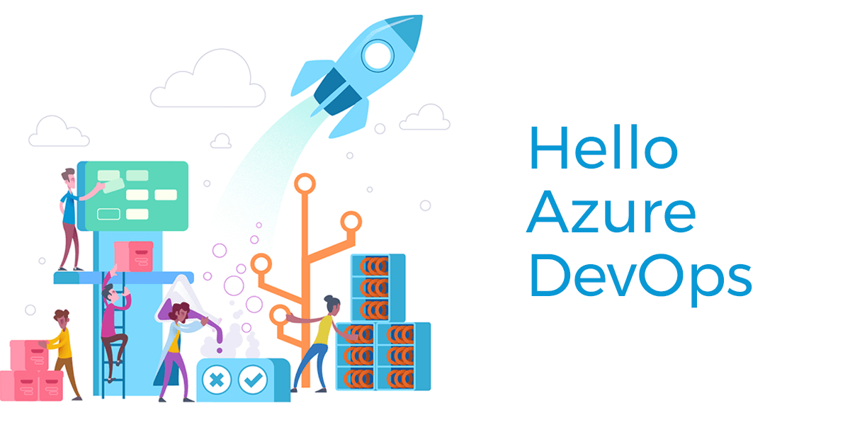

Slide 23
But I Want Something Easier!!!

Slide 24

But I Want Something Easier!!!
Azure Pipelines, CI/CD Made Simple
Any language/any platform
Can build code base from Azure Repos, GitHub, GitLab or Bitbucket
Configure builds/releases in YAML (config as code) or WYSIWYG Editor
Use build agents hosted by Microsoft or bring your own
Full control over what code goes where through Azure DevOps Portal

Slide 25
Azure Pipelines, CI/CD Made Simple
Any language/any platform
Can build code base from Azure Repos, GitHub, GitLab or Bitbucket
Configure builds/releases in YAML (config as code) or WYSIWYG Editor
Use build agents hosted by Microsoft or bring your own
Full control over what code goes where through Azure DevOps Portal

Slide 26
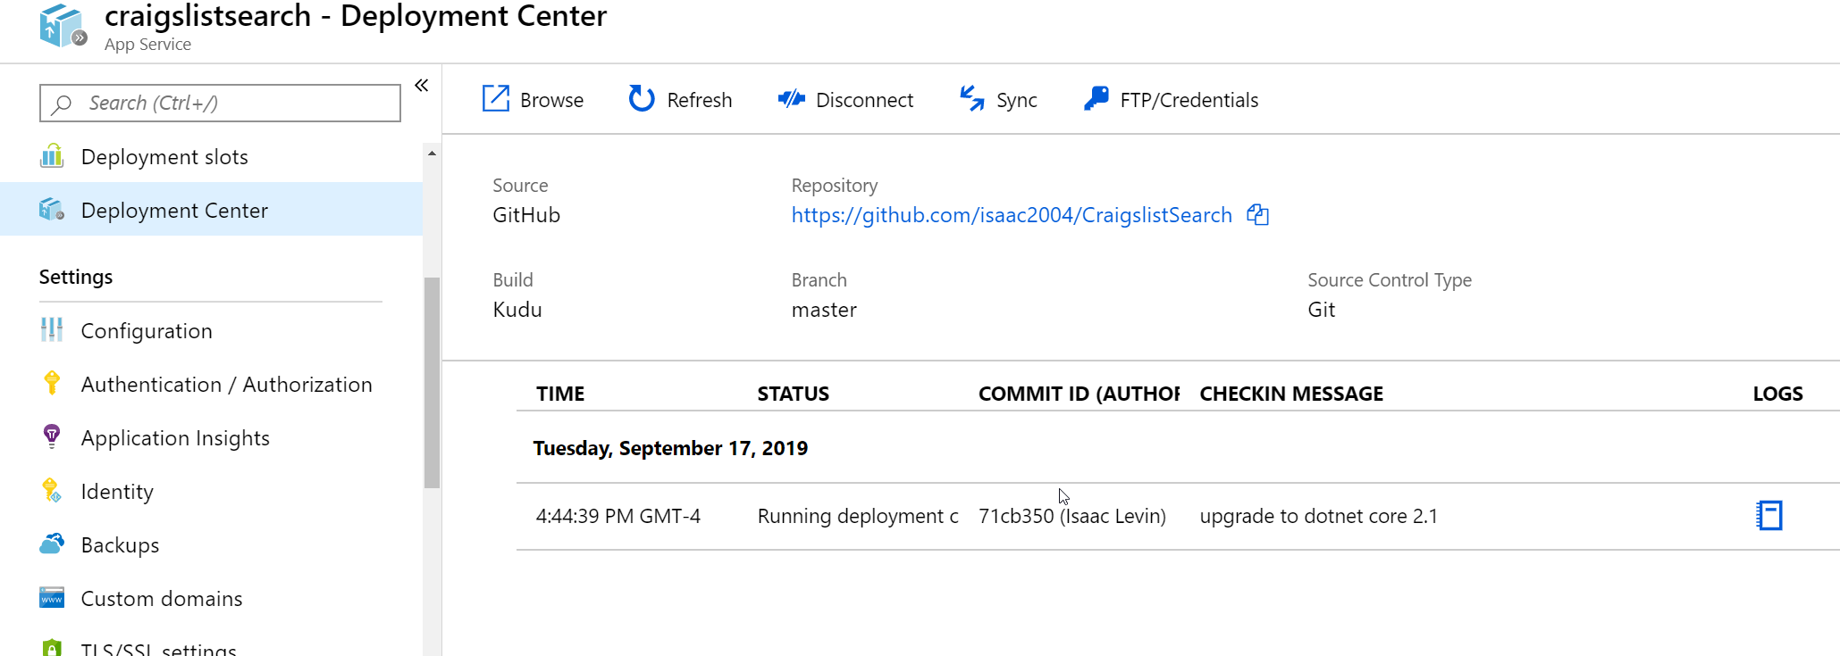
But I Want Something Easier!!!
Azure App Service Deployment Center
Point at source control (GitHub, Azure Repos, Bitbucket)
Configure your entire CI/CD through Azure Portal with Azure Pipelines or Kudu
Option to trigger push/sync deployment (OneDrive, Dropbox, FTP)

Slide 27
Rub Some DevOps on it ©Donovan Brown

Slide 28
Questions?

